Slide 1

Energy Consumption Prediction using ML and PowerBI

Slide 2
LET’S
GO

Slide 3
GOAL
SETTING
The primary goal is the construction of interpretable linear regression models capable of accurately predicting continuous energy consumption. This involves mastering the entire machine learning workflow: from rigorous data preprocessing and pipeline integration to robust model evaluation and coefficient interpretation.
RULE #1
RULE #2
RULE #3
RULE #4

Slide 4

Energy varies with temperature, building type, and usage;
Manual estimates are inaccurate and inefficient
Predict energy consumption using regression models: Linear Regression, Lasso, Ridge, Elastic Net.
Compare multiple regression algorithms.
Visualize results using Power BI.
Problem Statement
Objective

Slide 5
Data Loading
DL

Slide 6
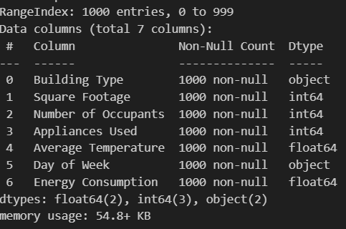
Data Overview
This file contains the testing dataset, which is used to evaluate the performance of the trained machine learning model.
Files: train_energy_data.csv and test_energy_data.csv
Total Records: Train_data:1000,7 Test_data:100,7;
Shape of the data is 1100,7
Columns:
Building Type: Residential, Industrial, Commercial.
Square Footage:the total area of the building.
Number of Occupants: the number of people occupying the building.
Appliances Used:the number of appliances used in the building.
Average Temperature:the average temperature of the building or climate area (in Celsius).;
Day of Week:whether the data point corresponds to a weekday or weekend.;
Energy Consumption:Numeric target variable representing the energy consumption of the building in kWh (kilowatt-hours). This is the value the model is tasked with predicting.

Slide 7

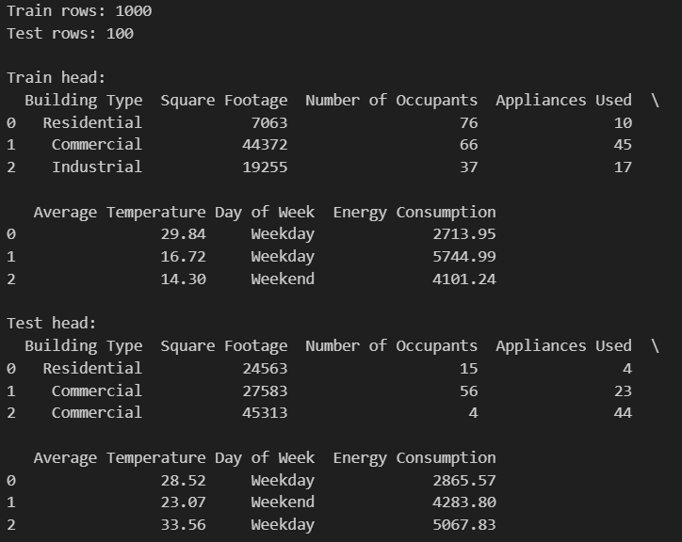
Data Loading
Data Shape and Structure
Rows, columns, and types checked to ensure modeling readiness.

Slide 8
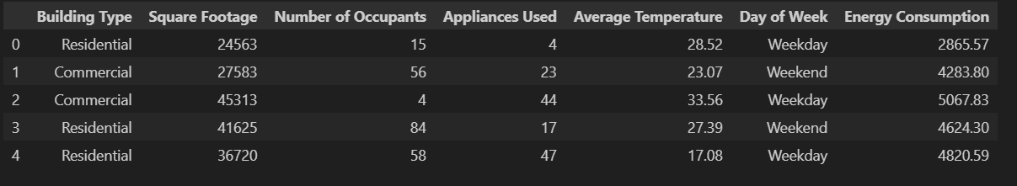
Data Loading
Data Shape and Structure

Slide 9
Data Cleaning & Preprocessing
DC&P

Slide 10
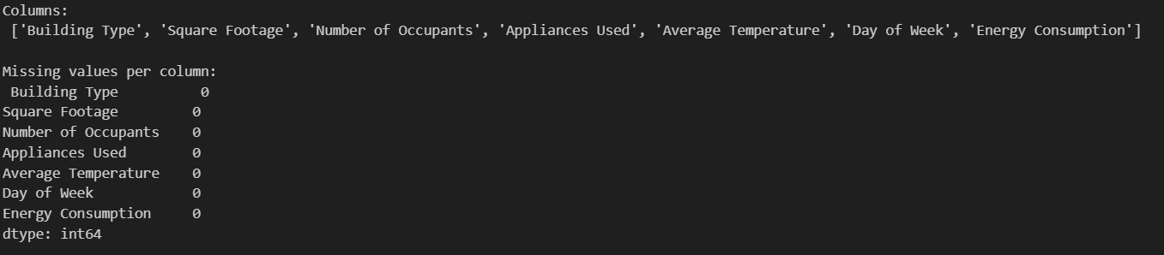
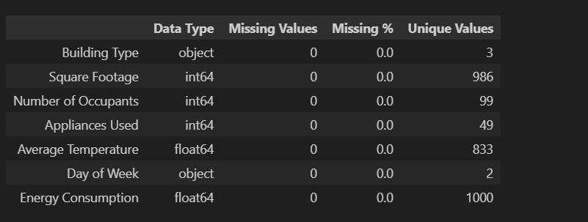
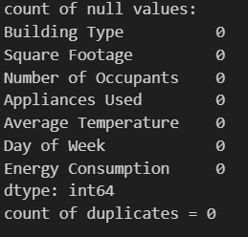
Data Cleaning & Preprocessing
Data Quality: No missing values and duplicates. All Columns are complete and ready for analysis.

Slide 11

Preprocessing Steps:
Missing value handling using imputation
Feature scaling using StandardScaler
Categorical encoding using OneHotEncoder
Train–test split
Pipeline Approach:
Ensures consistency
Prevents data leakage
In this step, I prepared data for Machine Learning using Scikit-Learn Pipelines. Numerical features were scaled using Standard Scaler, while categorical features were converted using One-Hot Encoding. ColumnTransformer ensures that each feature type is processed correctly in one unified pipelines, making the work clean, efficient and reusable.

Slide 12
Data Splitting
DS

Slide 13
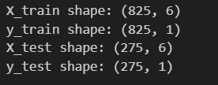
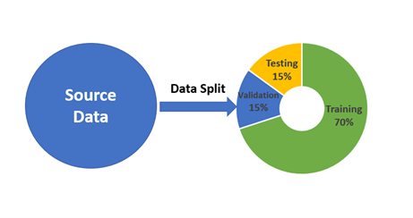
Data Splitting:
The data must be split into independent training and testing sets. This technique is known as Holdout Cross-Validation.
This prevents data leakage and gives a realistic estimate of performance on new, unseen data.
The target variable (Energy Consumption) is separated from the feature set (X).
The dataset is partitioned into 80% for training and 20% for testing. A random_state is set to ensure the split is reproducible.

Slide 14
Exploratory Data Analysis
EDA

Slide 15
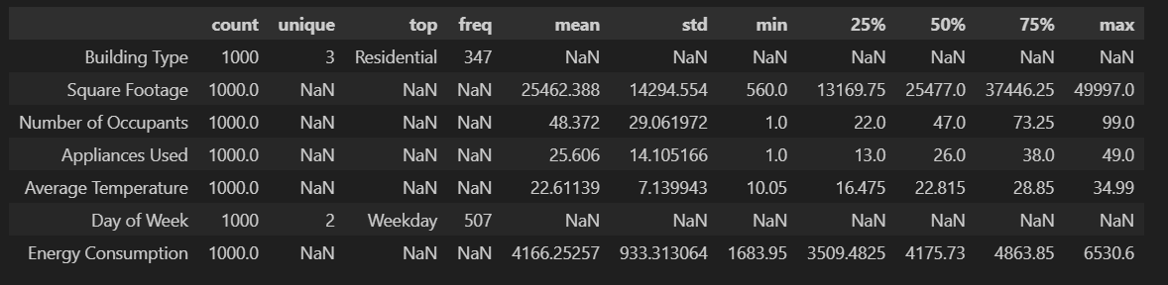
Dataset contains 1000 records with 6 input features and 1 target variable
Building Type has 3 categories: Residential, Commercial, Industrial
Square Footage ranges from 560 to ~50,000 sq. ft, indicating varied building sizes
Number of Occupants varies from 1 to 99, showing diverse usage intensity
Appliances Used ranges from 1 to 49, contributing to energy demand
Average Temperature ranges between 10°C and 35°C, capturing seasonal impact
Weekday usage (507 records) slightly exceeds weekend usage
Energy Consumption ranges from ~1,684 to ~6,530 units with a mean of ~4,166 units
No missing values observed; data is clean and suitable for modeling

Slide 16
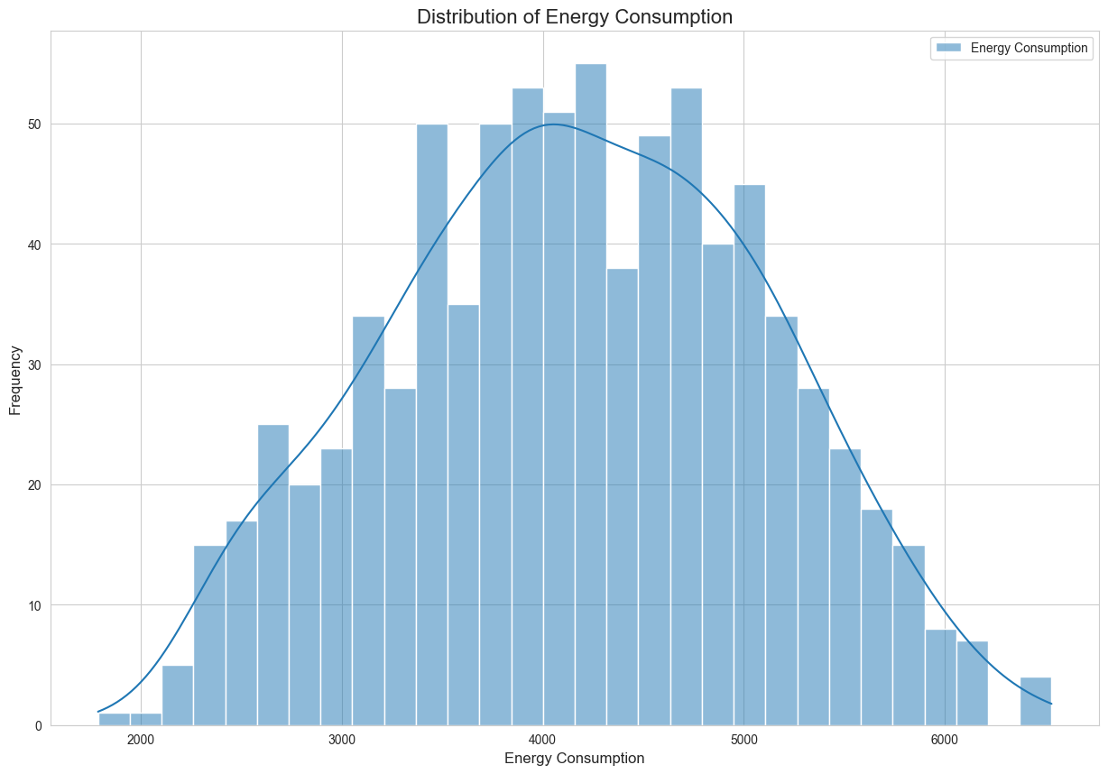
The distribution of energy consumption is nearly symmetrical and bell-shaped, resembling a normal distribution.
This is ideal for linear regression models, as it helps satisfy the assumption that the residuals will be normally distributed.
There are no obvious extreme outliers or strong skewness that would immediately necessitate complex transformations.
Distribution of Energy Consumption (Target Variable)

Slide 17
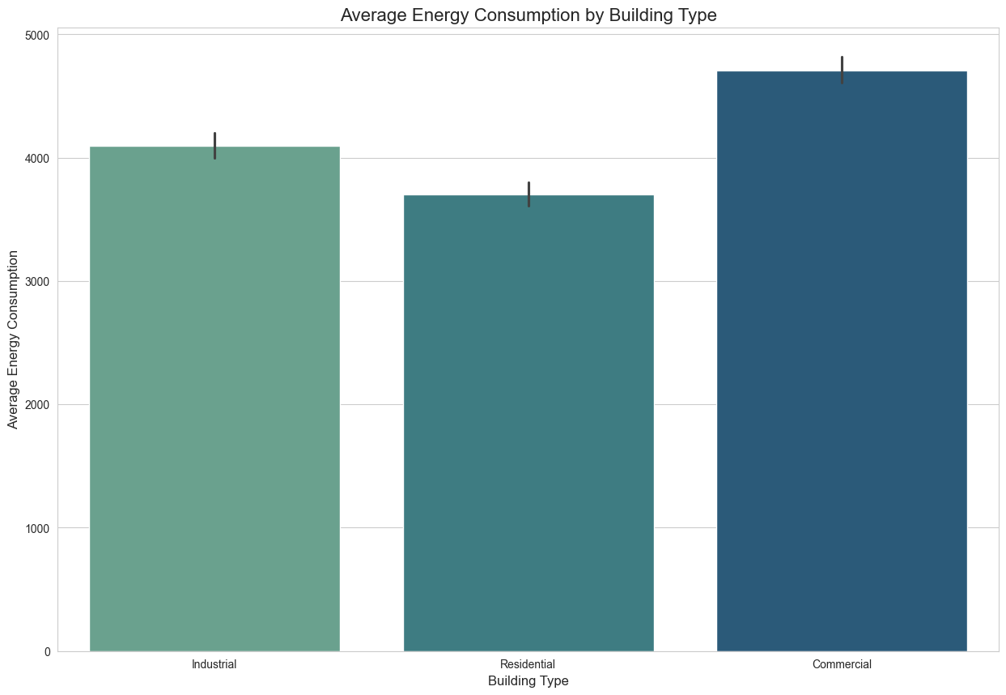
A clear, strong relationship exists between the building type and energy consumption.
Commercial buildings show the highest average consumption, followed by Industrial buildings, with Residential buildings having the lowest average usage.
This categorical feature is expected to be a highly important predictor in the final linear model.
Average Energy Consumption by Building Type

Slide 18
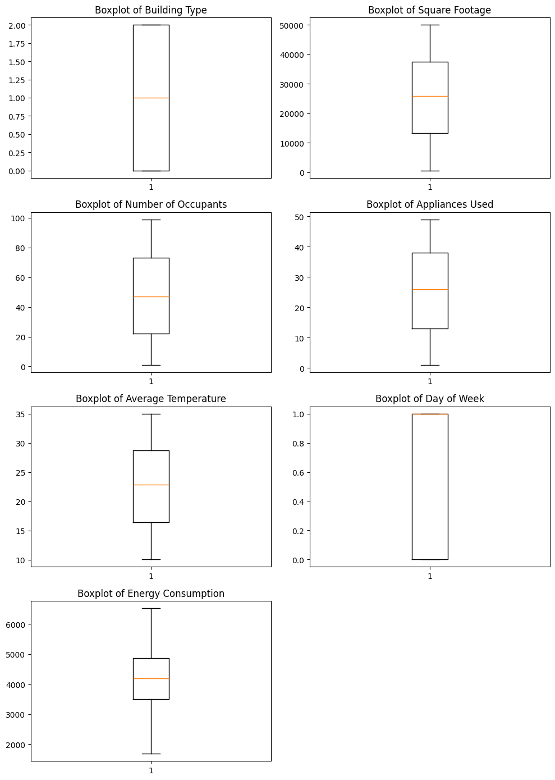
Using Boxplots to check for outliers

Slide 19
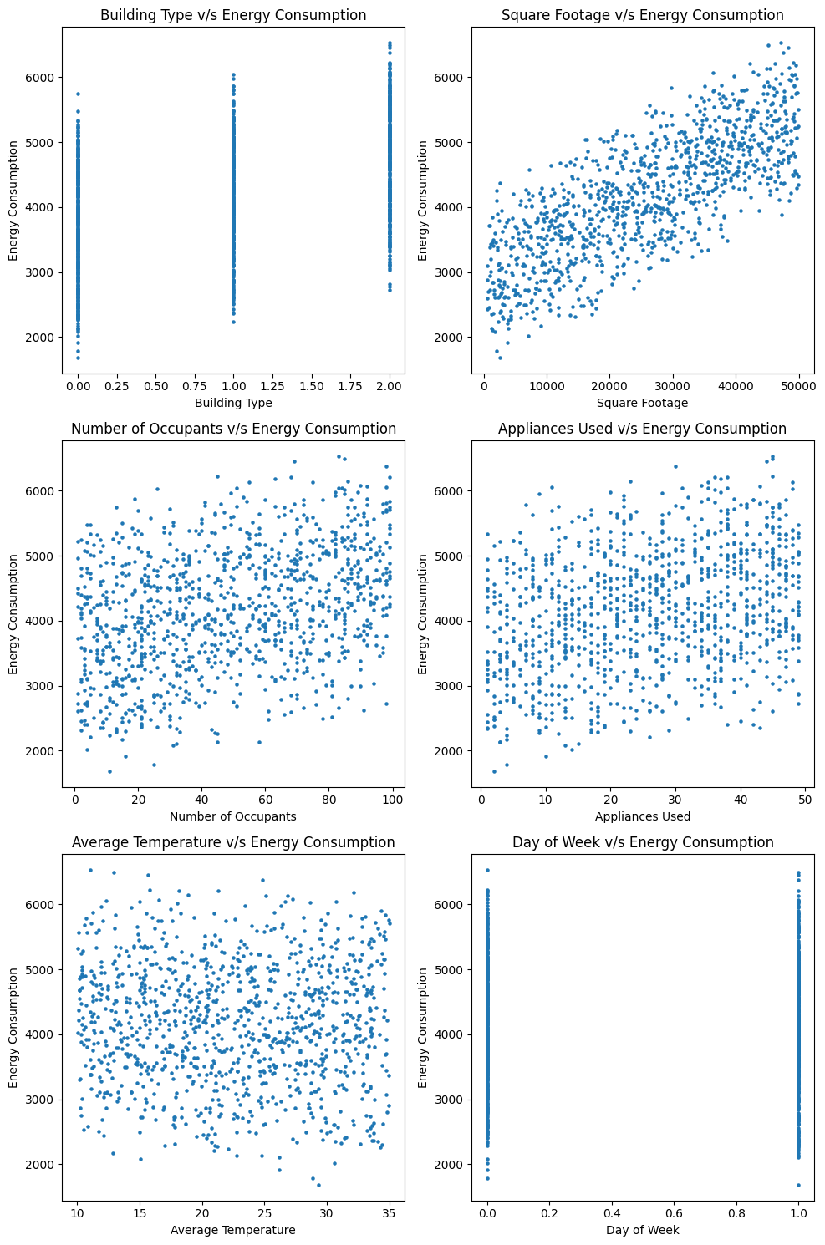
Using Scatterplots

Slide 20
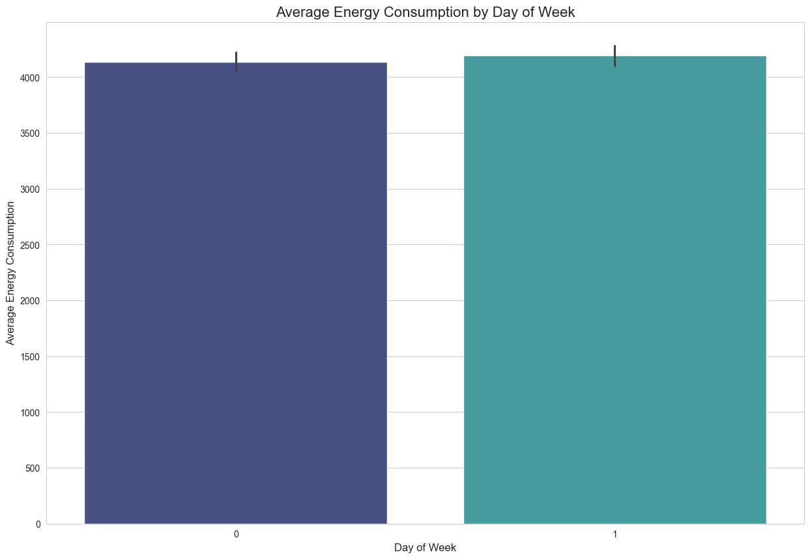
Average Energy Consumption by Day of Week (Categorical Feature Analysis)

Slide 21
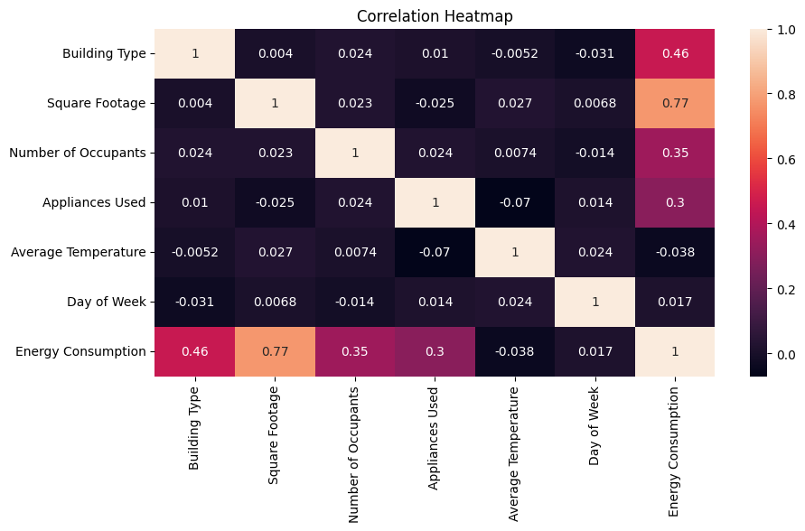
Correlation Heatmap (Numerical Feature Interdependence)
Visualization: Heatmap showing Pearson correlation coefficients between numerical features.
Heatmap represents Pearson correlation between numerical features
Square Footage shows the strongest positive correlation (0.77) with Energy Consumption
Building Type has a moderate positive correlation (0.46) with Energy Consumption
Number of Occupants shows a positive correlation (0.35) with Energy Consumption
Appliances Used also contributes positively (0.30) to energy usage
Average Temperature shows negligible correlation (-0.038) with Energy Consumption
Day of Week has very weak influence (0.017) on energy consumption
Low inter-feature correlation confirms minimal multicollinearity
Results justify the effectiveness of linear regression models

Slide 22
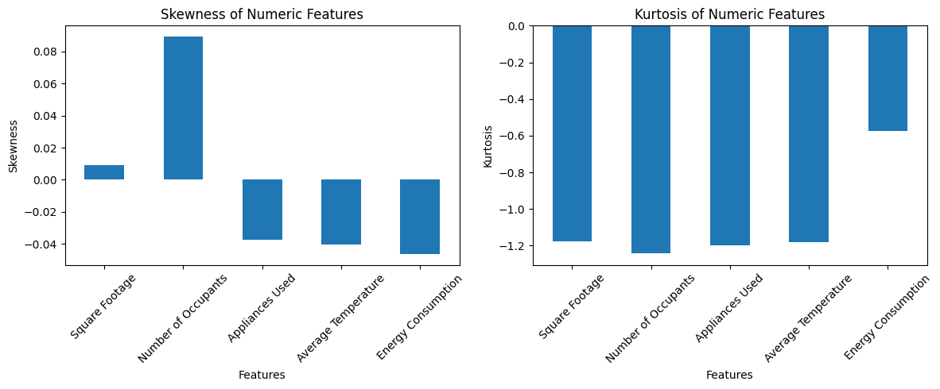
Skewness and Kurtosis

Slide 23
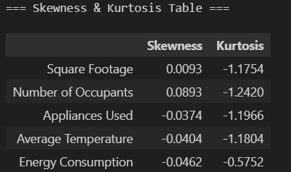
Skewness and Kurtosis
Skewness measures the asymmetry of the data distribution
Kurtosis measures the tailedness or presence of outliers
Observations:
Energy consumption shows slight positive skewness, indicating more high-value observations
Most numerical features are approximately symmetric
Kurtosis values are moderate, indicating no extreme outliers
Data distribution is close to normal, suitable for regression modeling
No heavy-tailed behavior affecting model performance

Slide 24
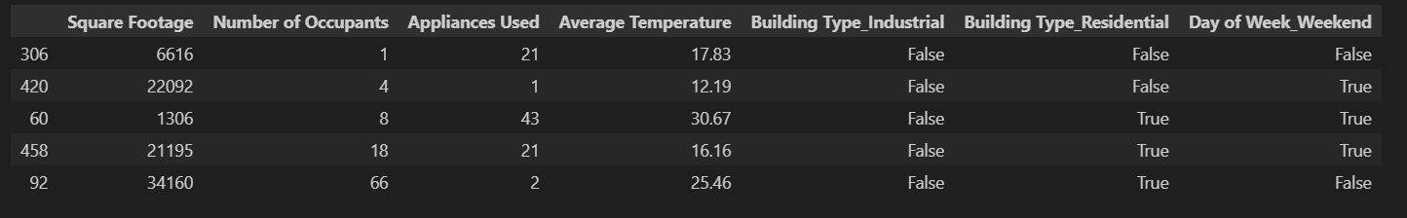
Feature Scaling (Standardization)
All numerical columns (after encoding, which includes the new binary columns) are selected.
A StandardScaler is initialized.
The scaler is fitted only on the training data (x_train) to calculate the mean and standard deviation.
Both the training and testing data are transformed using the parameters learned from the training data. This prevents data leakage from the test set into the training process.
The scaled arrays are converted back into DataFrames, preserving the column names and indices.

Slide 25
Regression Analysis
RA

Slide 26
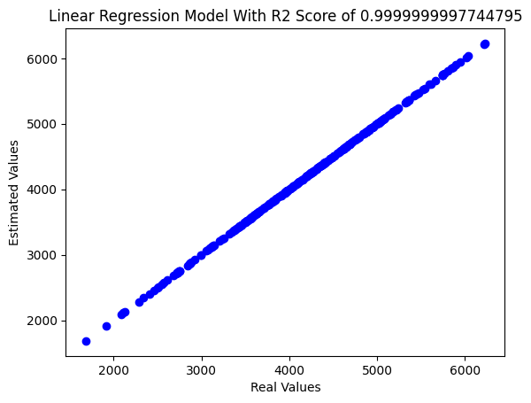
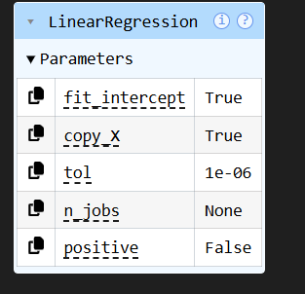
Linear Regression
MAE : 0.01150665865575816
MSE : 0.00018778899778099627
R2 Score : 0.9999999997744795

Slide 27
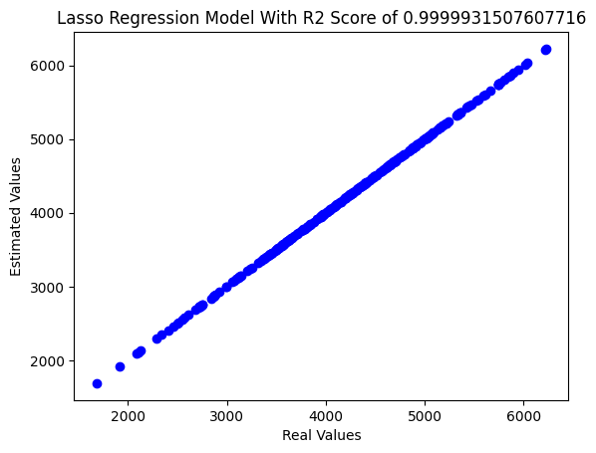
Lasso Regression
MAE : 1.9022975284643202
MSE : 5.70330297787443
R2 Score : 0.9999931507607716

Slide 28
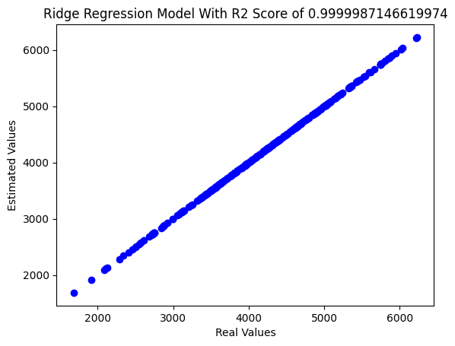
Ridge Regression
MAE : 0.8541577962709785
MSE : 1.0702899713499345
R2 Score : 0.9999987146619974

Slide 29
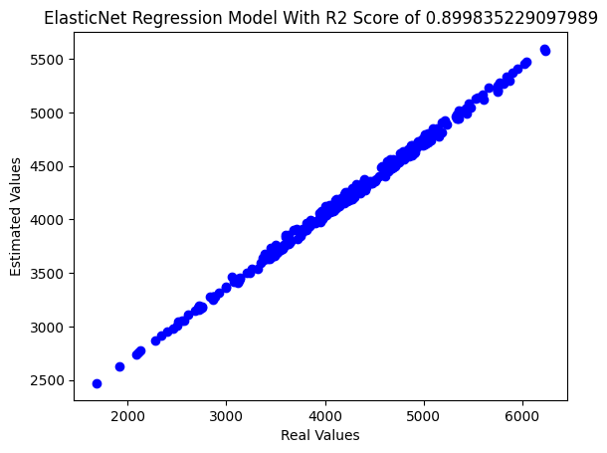
ElasticNet Regression
MAE : 238.0229596265862
MSE : 83406.3488091938
R2 Score : 0.899835229097989

Slide 30
Model Evaluation Metrics
MEM

Slide 31
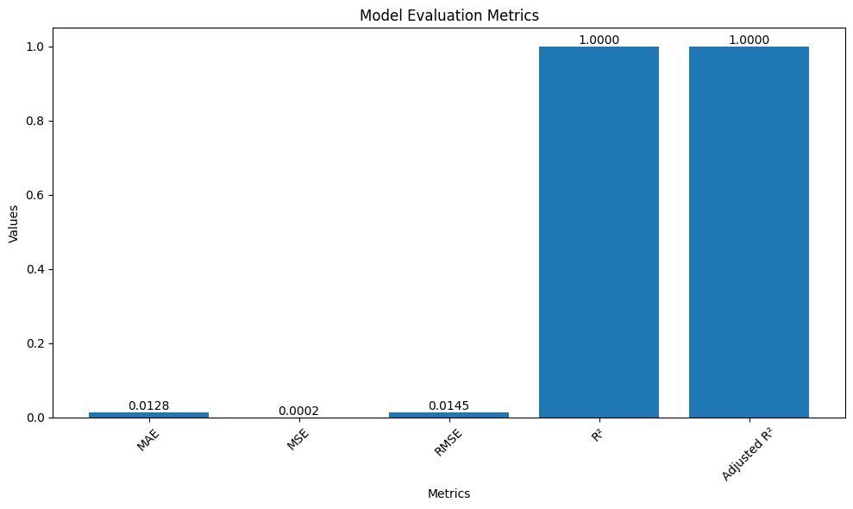
Model Evaluation Metrics
MAE: 0.012795191809526717
MSE: 0.00021131652438857414
RMSE: 0.014536730182148053
R2: 0.9999999997236053
Adjusted R²: 0.9999999997158195

Slide 32
MODEL PERFORMANCE RESULTS
MPR

Slide 33
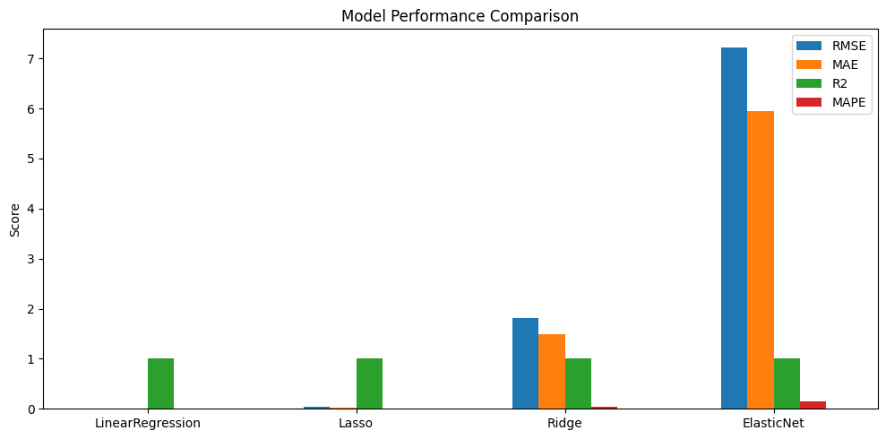

Slide 34
Multiple regression models were evaluated:
Linear Regression
Lasso Regression
Ridge Regression
ElasticNet Regression
Performance compared using RMSE, MAE, and R² score
Linear and Lasso Regression achieved the best performance
Ridge and ElasticNet showed slightly higher error values
Linear Regression selected as final model due to:
Highest accuracy
Simplicity
Better interpretability

Slide 35
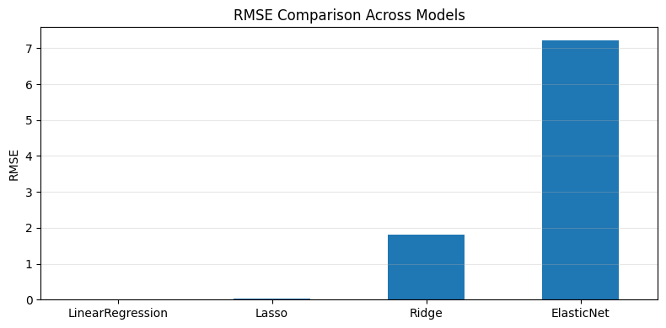

Slide 36


Slide 37
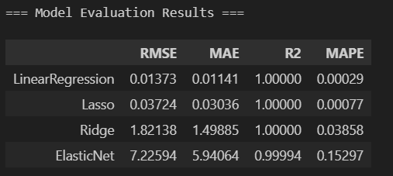
Key Results:
Linear & Lasso Regression performed best
RMSE and MAE values are very low
R² score ≈ 1.00
Conclusion:
Models predict energy consumption accurately
Higher MAE in ElasticNet indicates over-regularization, making it unsuitable for this dataset.

Slide 38
Actual vs Predicted
AP

Slide 39
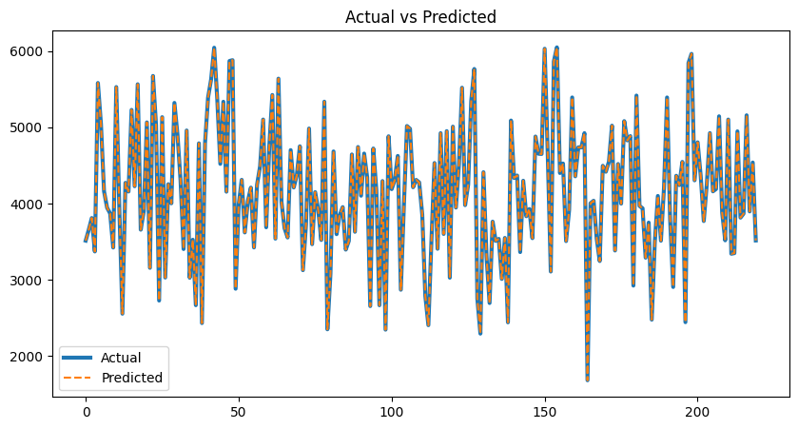
Actual vs Predicted Analysis
Scatter plot compares actual energy consumption vs predicted values
Data points closely follow the 45° reference line
Indicates high prediction accuracy across all energy ranges
Very small deviation between actual and predicted values
Confirms the model generalizes well on unseen test data
No visible systematic over-prediction or under-prediction

Slide 40
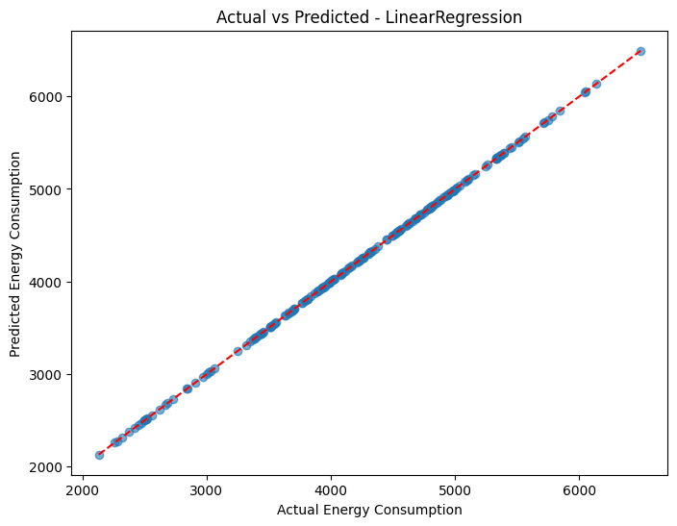
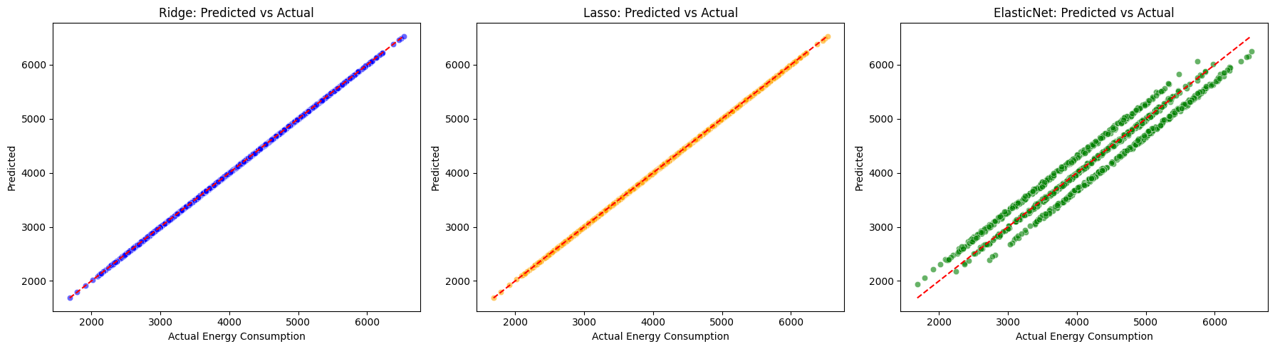
Observation:
Predicted values closely match actual energy consumption
Points lie near the diagonal line
Interpretation: This confirms high predictive accuracy with minimal error.

Slide 41
ERROR ANALYSIS
EA

Slide 42
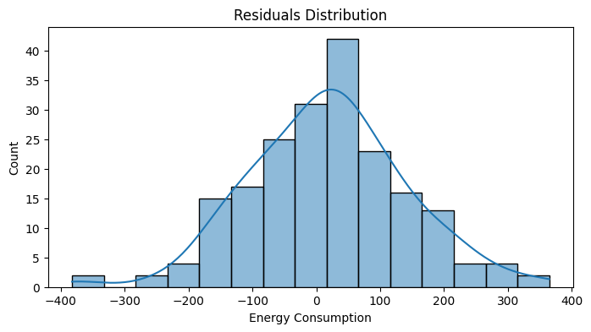
Error Analysis: Residuals
Error values are centered around zero
Majority of prediction errors fall within a narrow range
Distribution is approximately symmetric
Indicates no bias in the model predictions
Confirms model assumptions for linear regression are satisfied
Confirm normality and check conditional errors by building type

Slide 43
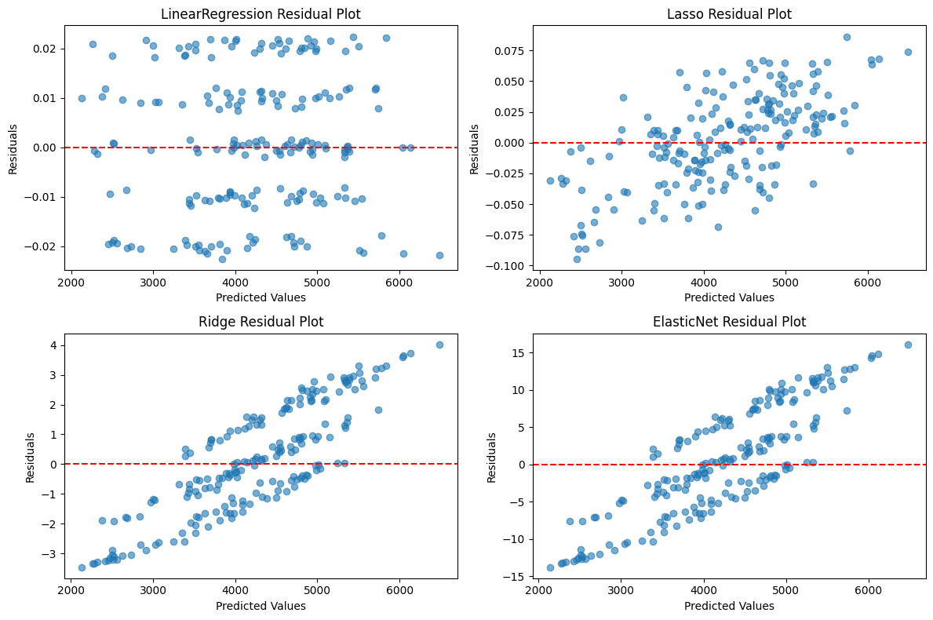
Residual Analysis:
Errors are centered around zero
No systematic bias observed across building types
Conclusion: The model satisfies linear regression assumptions.

Slide 44
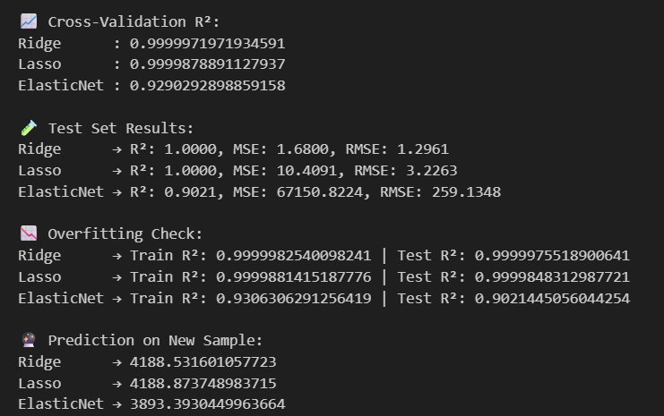

Slide 45
Power BI
PBI

Slide 46
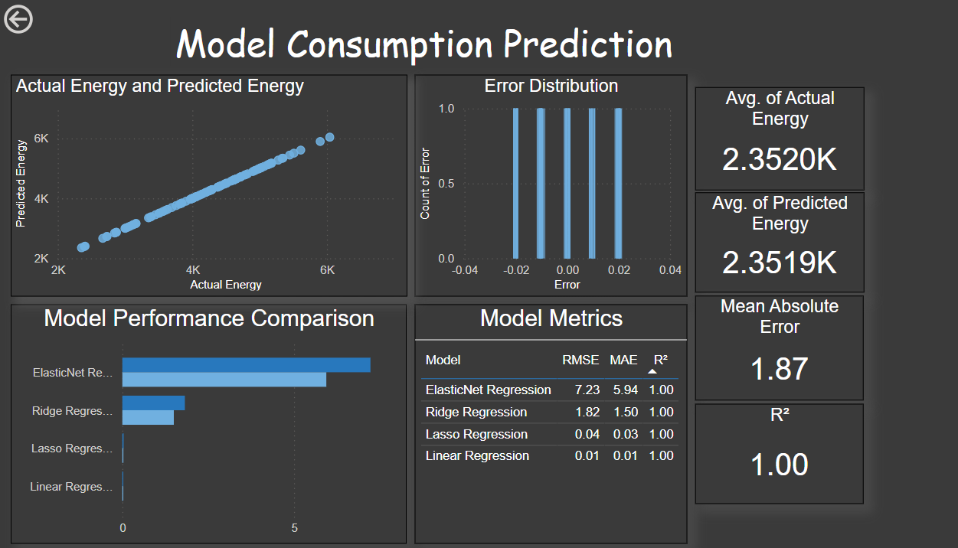

Slide 47
Additional Model
AM

Slide 48
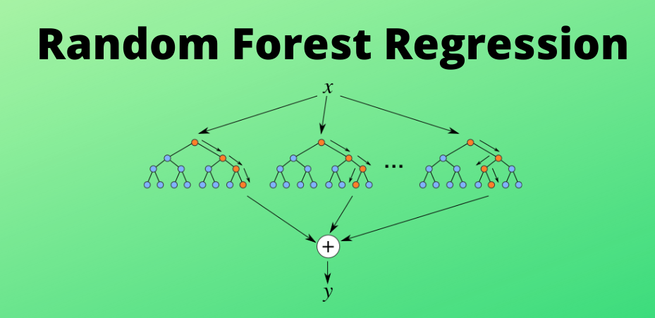
Additional Model-Random Forest Regression
Overview: Random Forest is an ensemble learning method that combines multiple decision trees to improve prediction accuracy and reduce overfitting.
Result:
R² Score: 0.983
Observation:
High prediction accuracy was achieved
However, performance was slightly lower than linear regression models
Conclusion: Although Random Forest performed well, linear regression was preferred due to higher accuracy and better interpretability.

Slide 49
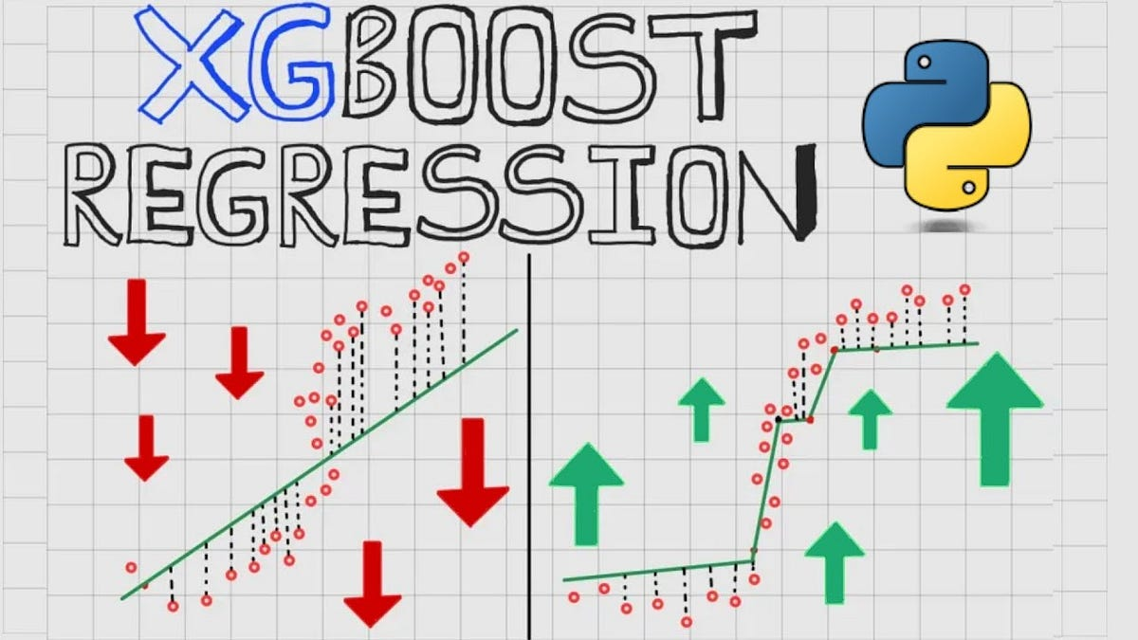
Additional Model-XGBoost Regressor
Overview: XGBoost (Extreme Gradient Boosting) is an advanced ensemble algorithm that builds boosted decision trees sequentially to improve prediction performance.
Result:
R² Score: 0.987
Observation:
XGBoost achieved high predictive accuracy
Performance was comparable but not superior to linear regression models
Conclusion: XGBoost achieved strong performance but did not outperform linear regression, which was selected for simplicity and transparency.

Slide 50
Model Comparison
Model | R² Score
Linear Regression | ~1.00
Ridge / Lasso | ~1.00
Random Forest | 0.983
XGBoost | 0.987

Slide 51
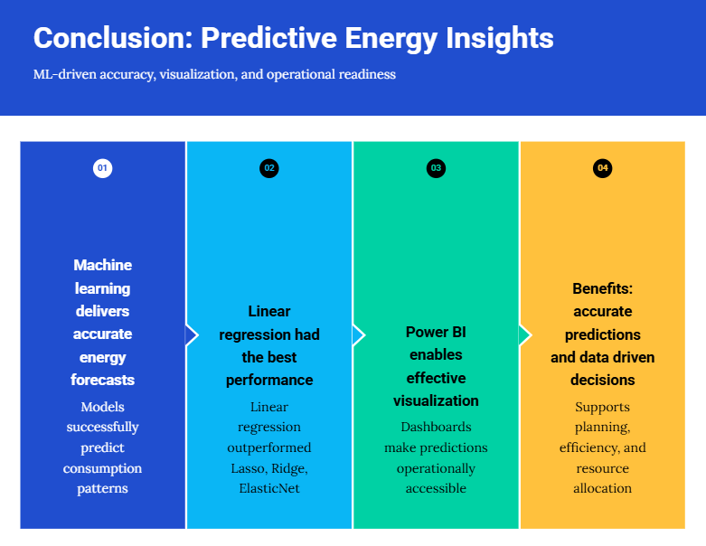

Slide 52
THANKS
FOR
WATCHING

